Slide 1
MA388 MAJ Daniel Baller
Lesson 1

Slide 2
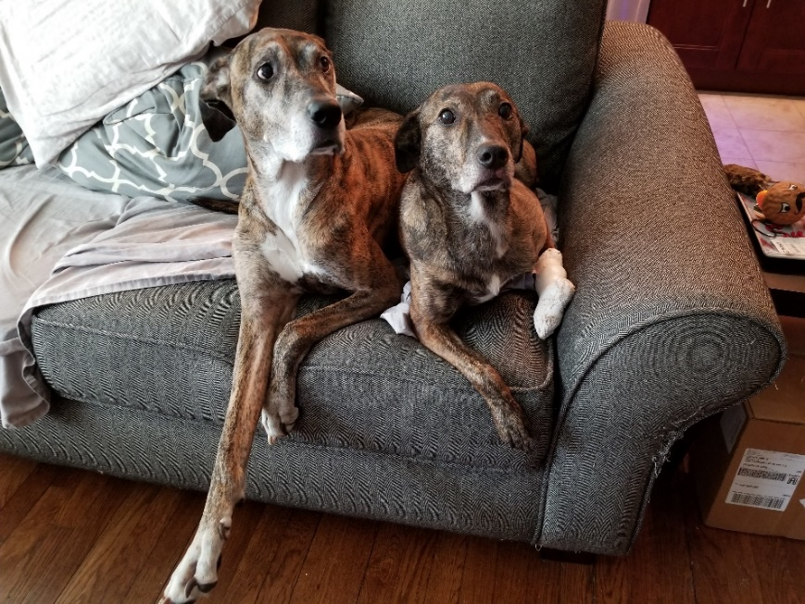
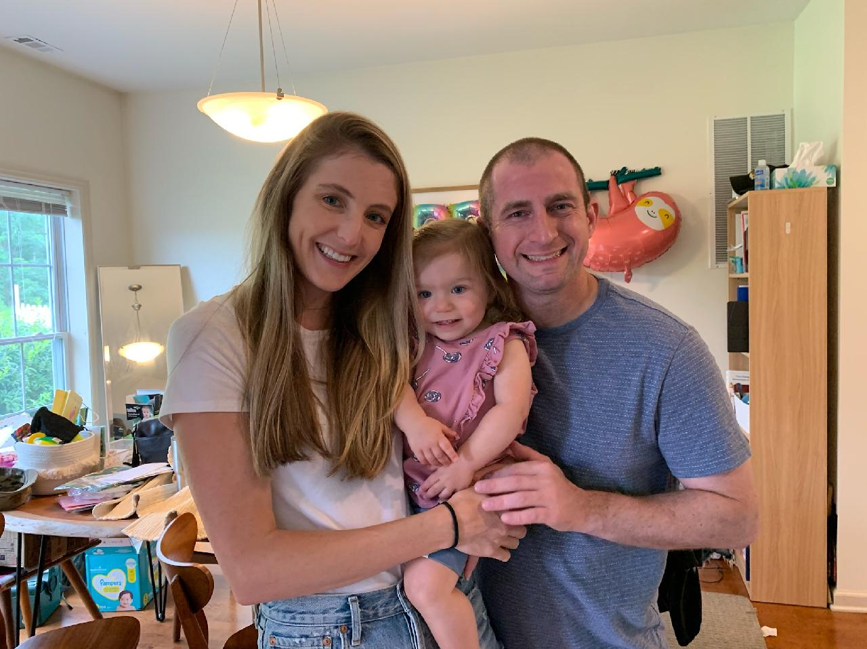
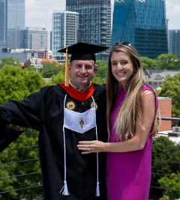
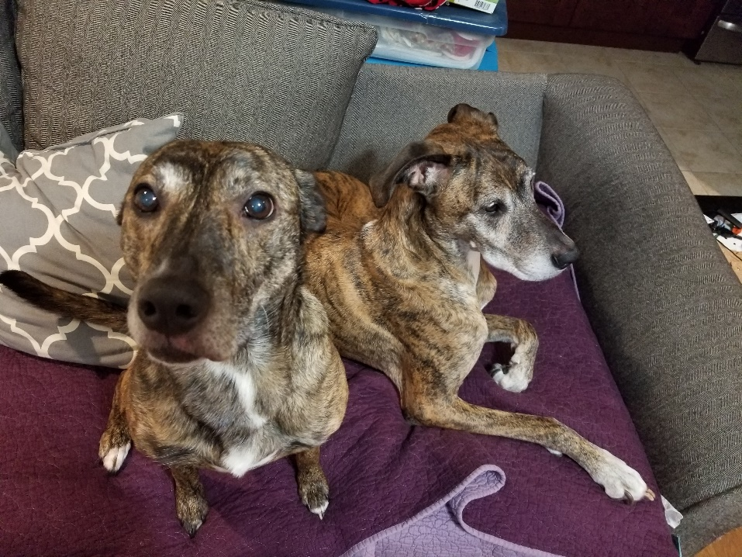
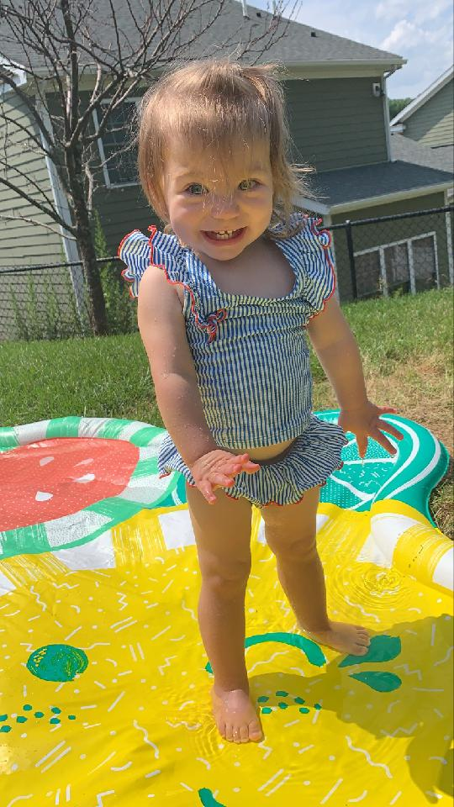
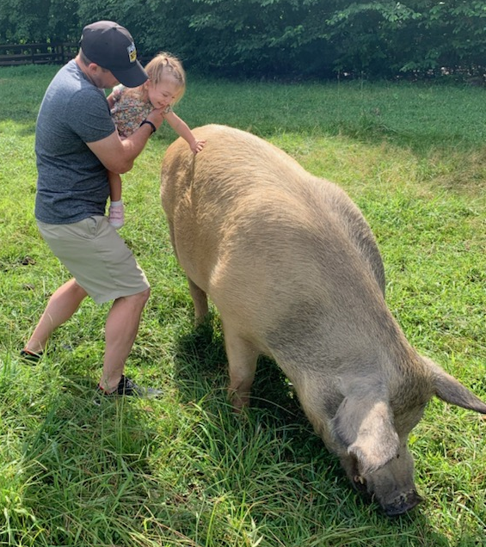
About Me…
MAJ Daniel Baller
Hillsboro, OR
Undergraduate: OR, USMA 2008
Grad School: Masters OR, Georgia Tech 2018
Intelligence Officer and Counter Intel Special Agent
FA49 ORSA
Duty Stations:
Ft. Huachuca
Ft. Hood, (Balad, Iraq)
Korea (Camp Casey, Camp Humphreys, Yongsan)
Hobbies: Hiking, Grilling, Seahawks Football

Slide 3
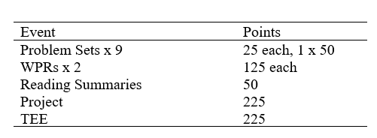
Point Breakdown

Slide 4
AI
I teach B1, C1
Research meetings throughout the week.
During the duty day:
Use the scheduling assistant: send me an email and propose 2/3 times. To set up AI or call/message on teams
After the duty day:
Send me an email or message me on teams. If I see it, you will get a response. If not, you will here from me first thing the next day.
If I have not responded in 48 hours please message me again.
Open AI: Study days

Slide 5
You can expect me to...
Treat you with respect – be kind
Be approachable and available
Get to know you as an individual
Be enthusiastic and show relevance of the course to your life
Set the conditions for your success
Understand you have other things going on

Slide 6
I expect you to...
Keep an open mind and grow as future officers in our profession
Be responsible for your learning
Use a variety of sources to aid in understanding
Keep me informed of what’s going on in your life
Actively participate in class

Slide 7
Assignments
Turned in hard copy at the start of class.
Can be turned in on blackboard if you will be missing class.
Require a coversheet, works cited page and stapled if more than one page.
Do not use a printer that’s a mess.

Slide 8


Course Texts
Reading Summaries

Slide 9
Tech Orientation
MS Teams
Blackboard Page

Slide 10
Department of Mathematical Sciences Academic Integrity Brief AY 22-2
v2

Slide 11
Introductions
Introductions

Slide 12
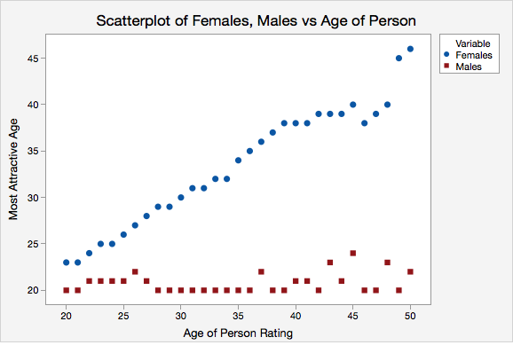
OK Cupid Data
Lock Morgan, Kari, “Multivariable Thinking and Data Visualization”, JSM 2018, 1 Aug 18.

Slide 13
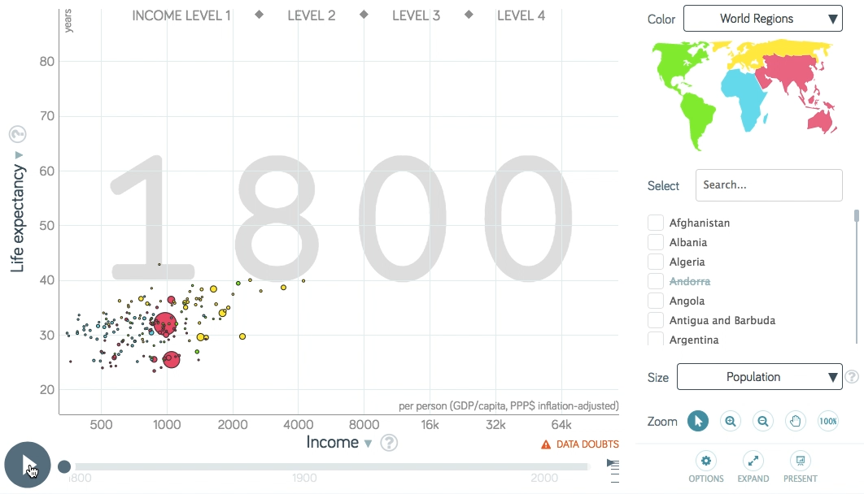
Gapminder
https://www.gapminder.org/
Hans Rosling’s 200 Countries, 200 Years, 4 Minutes

Slide 14
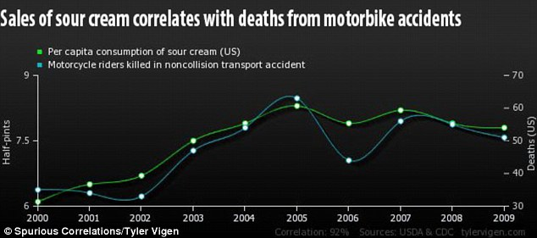
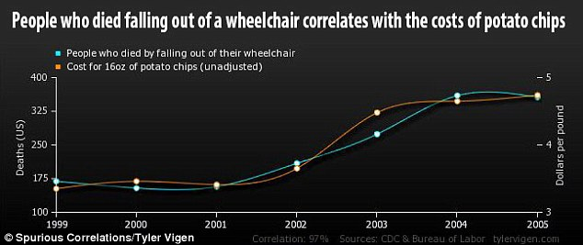
Correlation vs. Causation

Slide 15
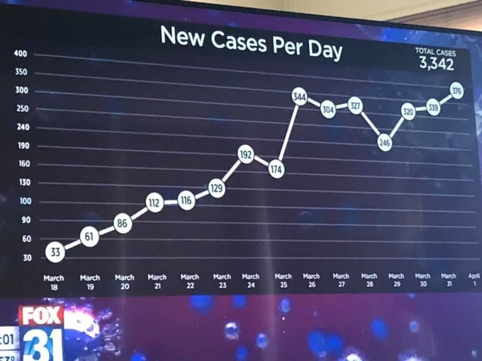

Slide 16
